Slide 1

Contract Monthly Claim system (CMCS) PRESENTATION

Slide 2
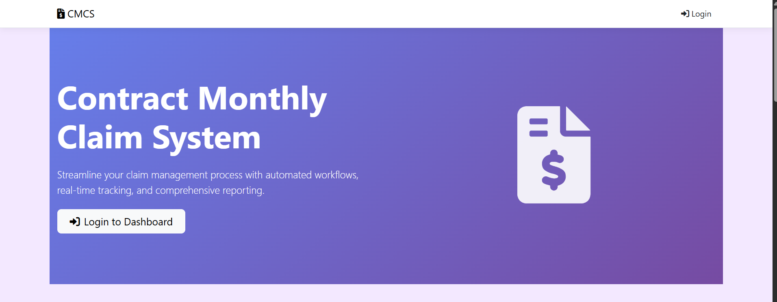
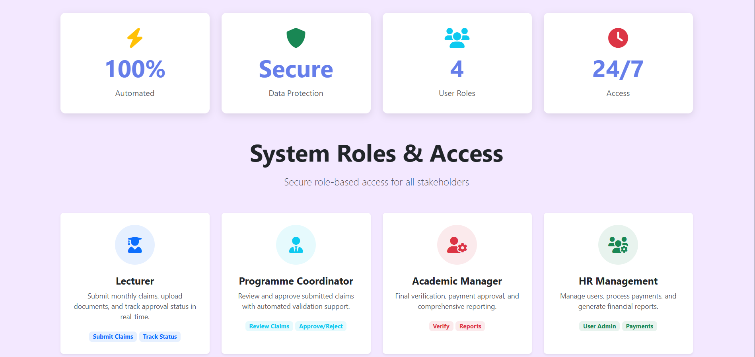
Contract Monthly Claim System Homepage (1) This slide shows the homepage of the contract monthly claim system (CMCS). The first thing you see is the title and a short description explaining that the system helps streamline claim management with automation and real-time tracking. There is a “login to dashboard” button which lets users sign into the system. Below that, the slide highlights some key stats like the system being 100% automated, secure, supporting four different user roles, and offering 24/7 access. The slide also introduces the different user roles—lecturer, programme coordinator, academic manager and HR management—and briefly explains what each role is responsible for inside the system.

Slide 3
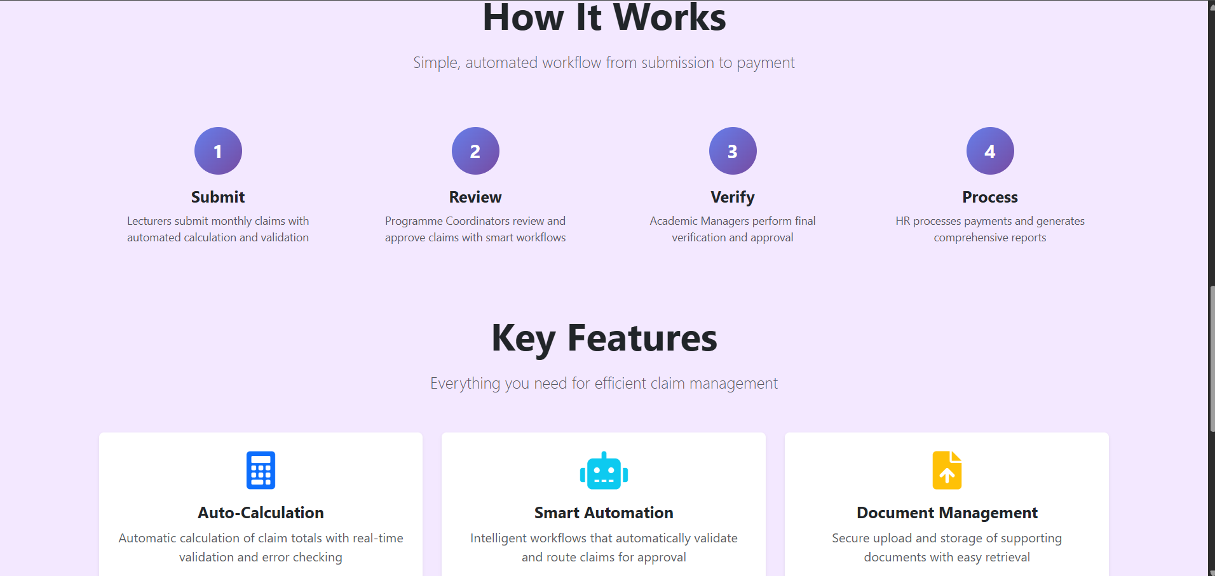
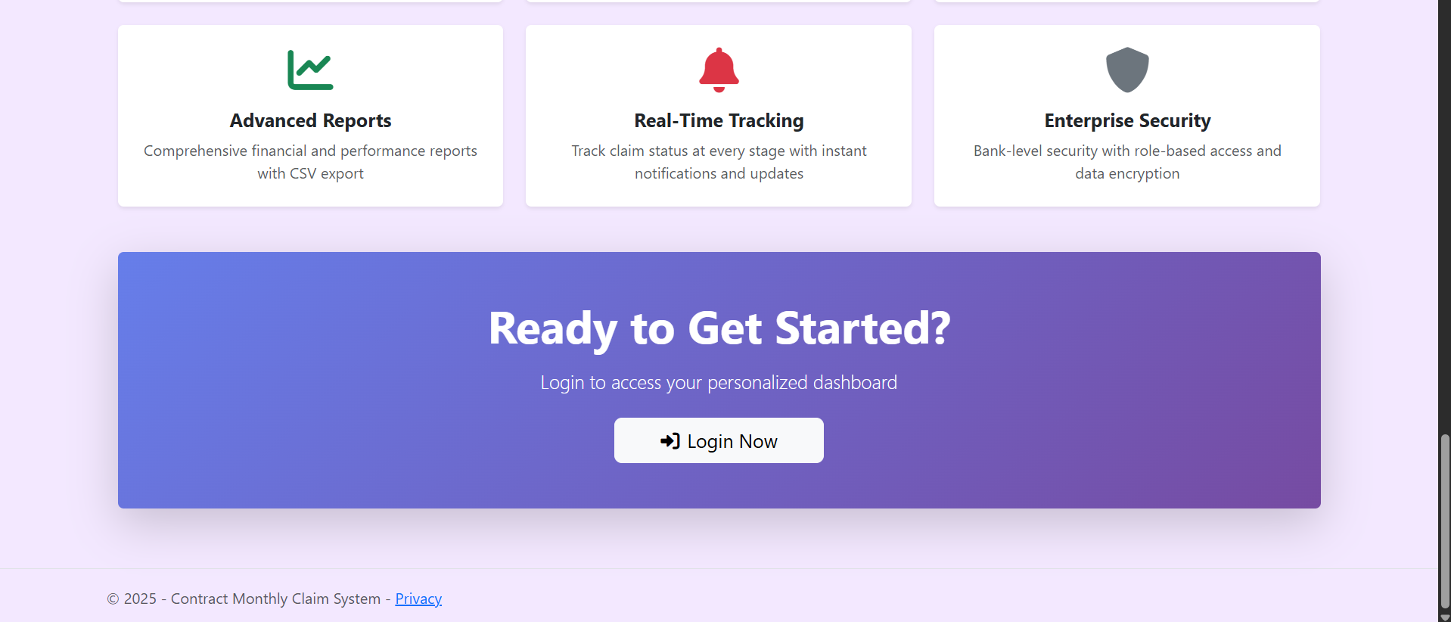
Homepage (2) How it works & key features This slide explains the basic workflow of the claim process. It starts with “submit,” where lecturers upload their monthly claims. Then the programme coordinator reviews the claim, followed by the academic manager verifying it. Lastly, HR processes the payment. The slide then lists the key features of the system. Auto-calculation helps calculate claim amounts automatically. Smart automation validates and routes claims to the right people. Document management allows easy uploading and storing of supporting files. Advanced reports give financial insights, while real-time tracking shows claim progress. Enterprise security ensures that data is protected with secure access and encryption.

Slide 4
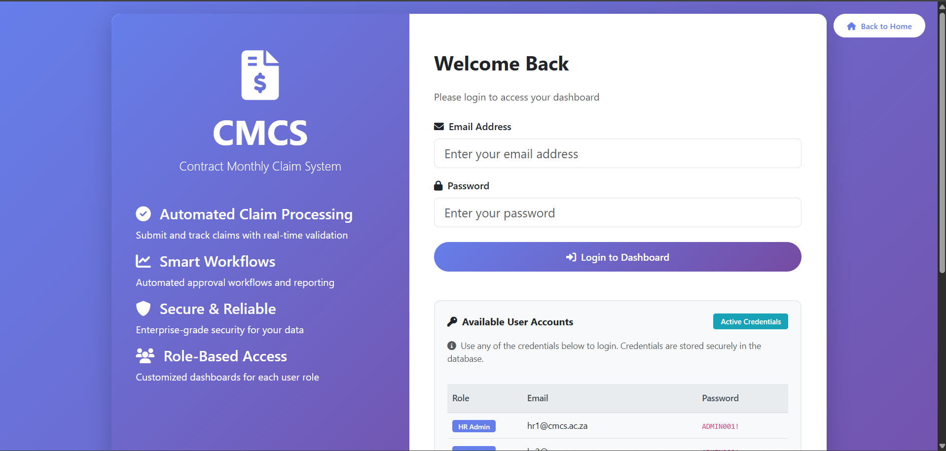
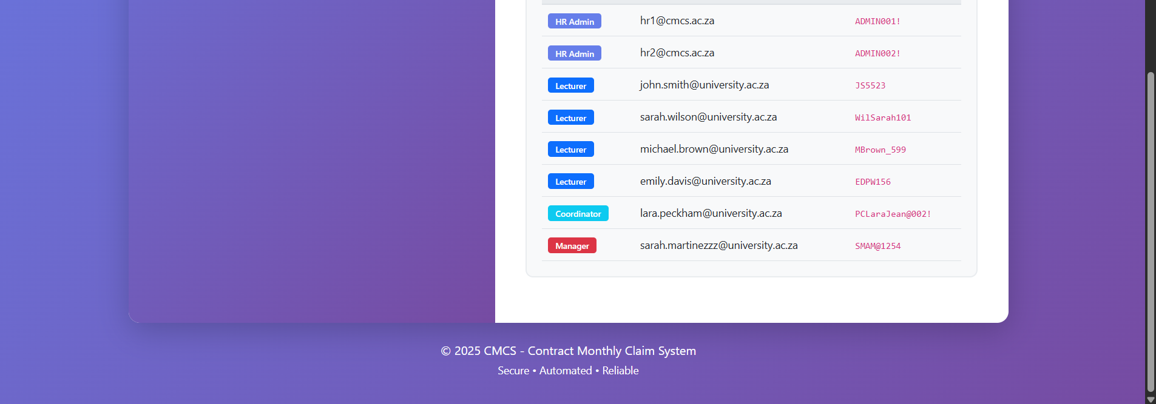
Login Page
This is the login page where users can access the system. There's a simple form where you enter your email and password to get into your dashboard. On the left side, you can see the main features of CMCS like automated claim processing, smart workflows, security, and role-based access. Below the login form, there's a section showing available user accounts with different roles like HR admin, lecturer, coordinator, and manager. Each account has its own login credentials that are stored securely in the database.

Slide 5
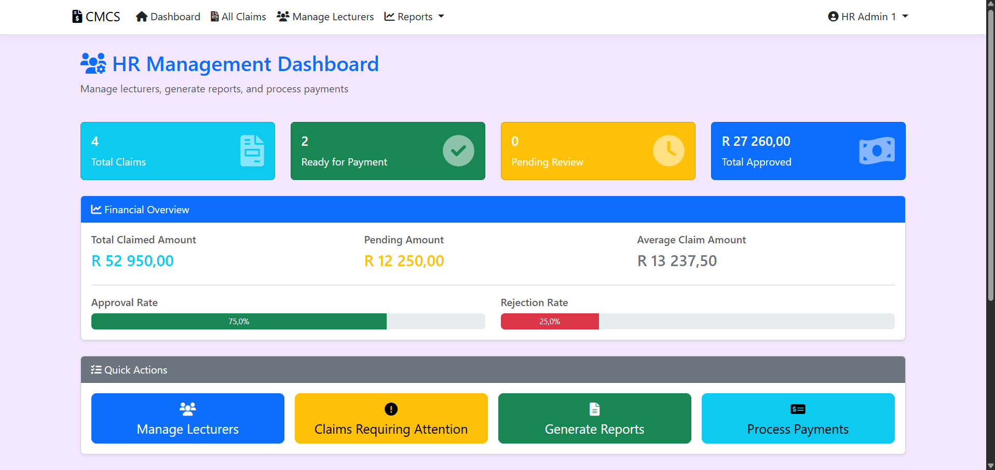
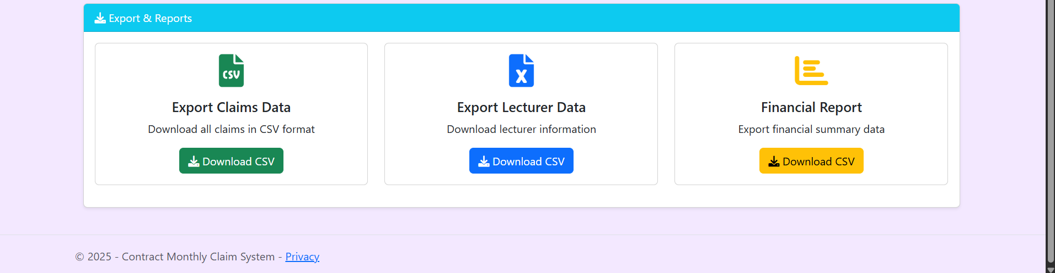
HR Management (1) Dashboard The HR dashboard gives a quick overview of all claims in the system. At the top, there are four boxes showing total claims, claims ready for payment, pending reviews, and total approved amount. The financial overview section shows the total claimed amount, pending amount, and average claim amount, along with approval and rejection rates displayed as progress bars. There are quick action buttons to manage lecturers, check claims that need attention, generate reports, and process payments. At the bottom, you can export data in different formats like CSV for claims, lecturer information, and financial reports.

Slide 6
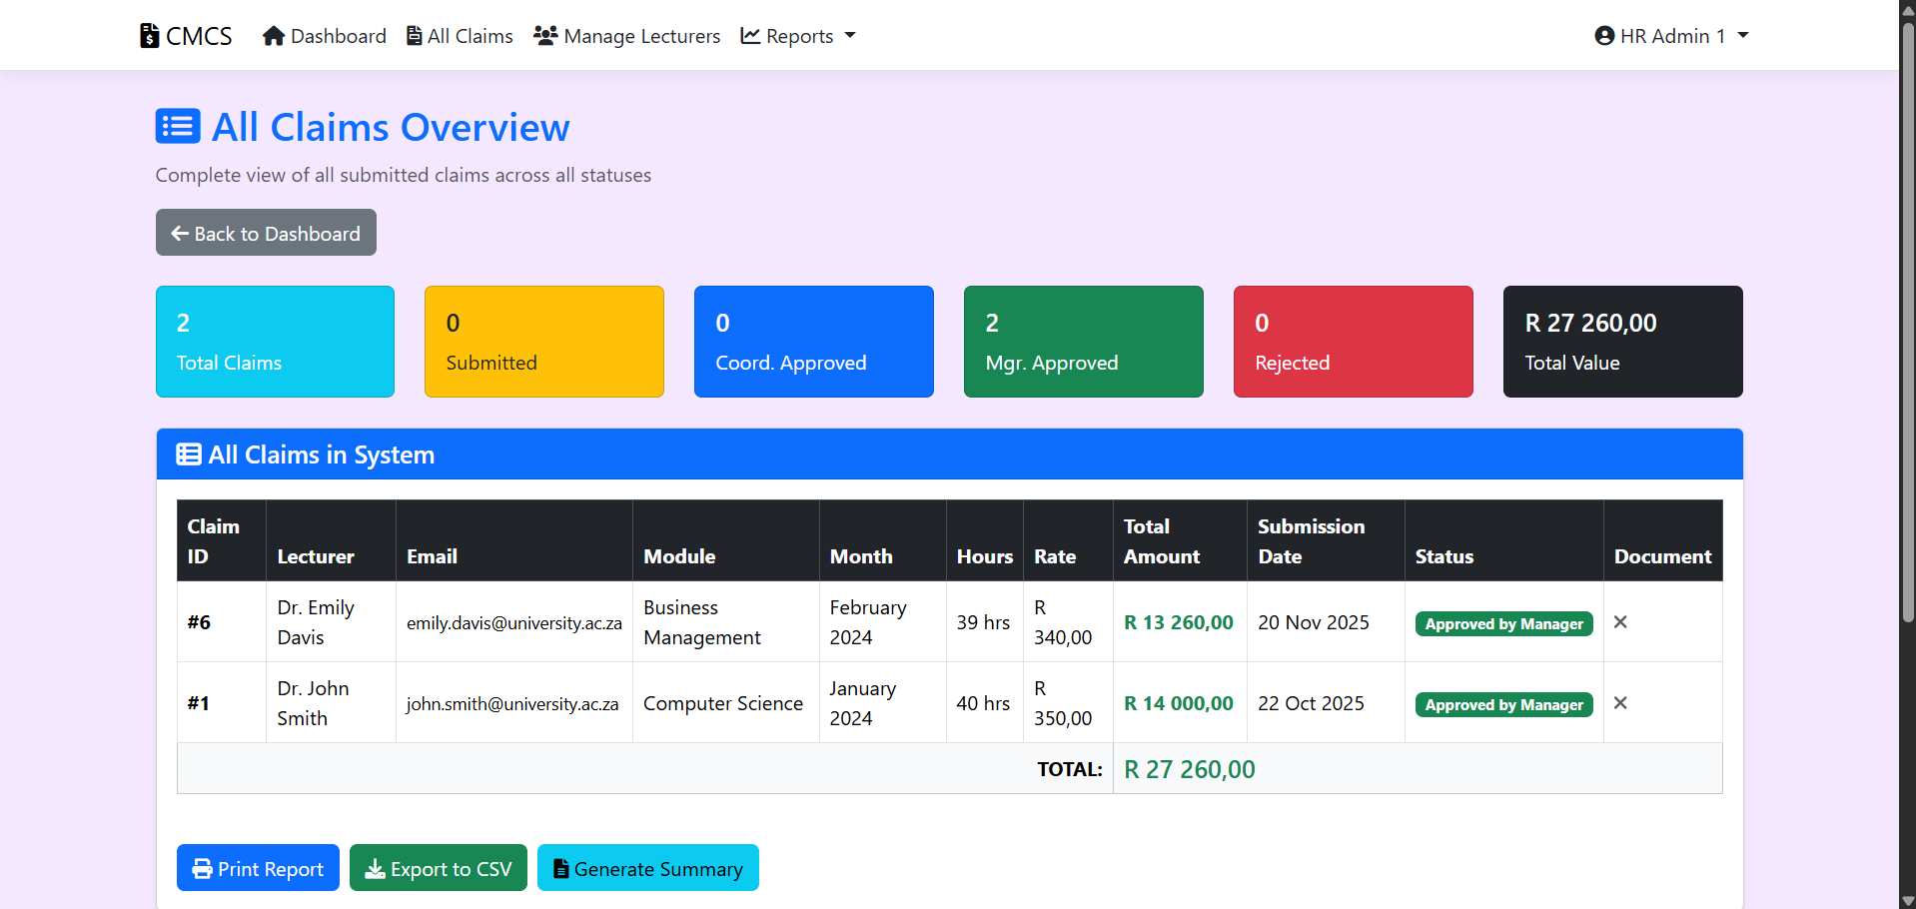
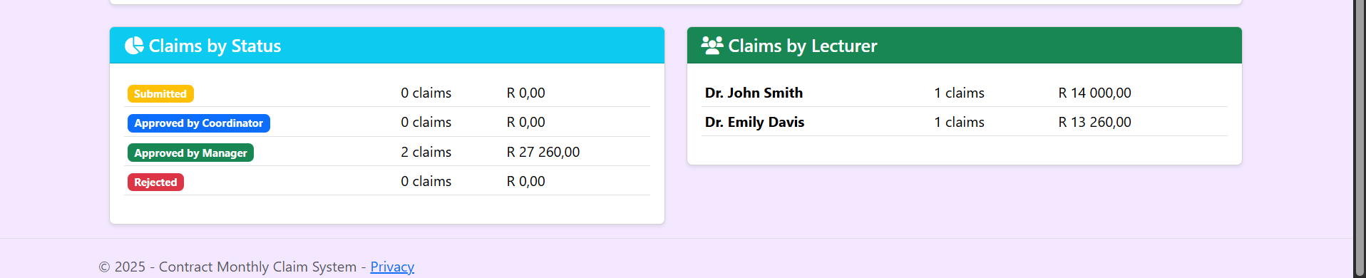
HR Management (2) All Claims Overview This page shows a complete view of all claims in the system. The top section has coloured boxes showing how many claims are in each status - submitted, coordinator approved, manager approved, and rejected, plus the total value. Below that is a table listing all claims with details like the lecturer name, email, module, month, hours worked, rate, total amount, submission date, and current status. You can also see claims grouped by status and by lecturer in the bottom sections. There are buttons to print reports, export to CSV, or generate a summary.

Slide 7
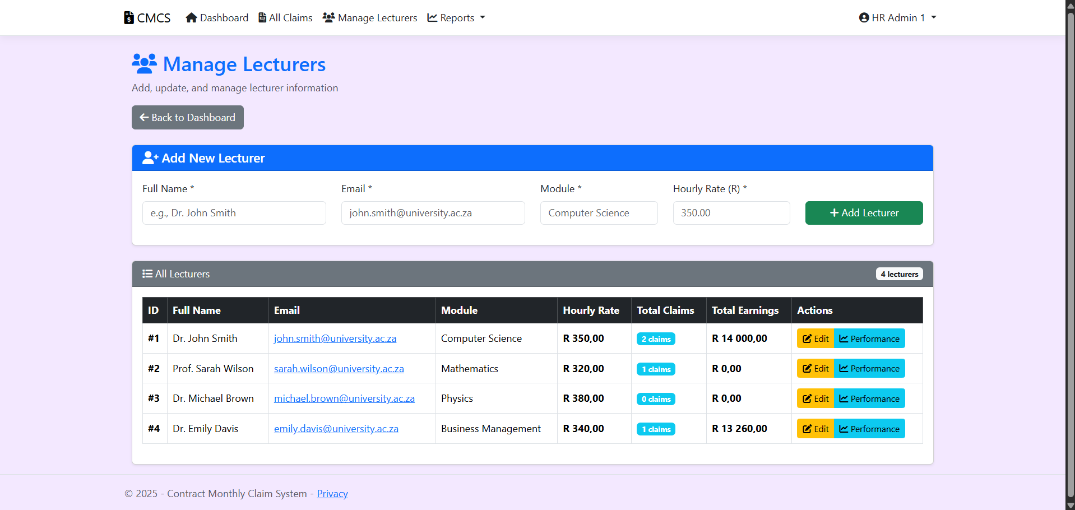
HR Management (3) Manage Lecturers This is where HR admins can add and manage lecturer information. At the top, there's a form to add a new lecturer where you enter their full name, email, module they teach, and hourly rate. Below that is a table showing all lecturers currently in the system. For each lecturer, you can see their ID, name, email, module, hourly rate, total number of claims they've submitted, and total earnings. There are action buttons to edit their details or view their performance history.

Slide 8
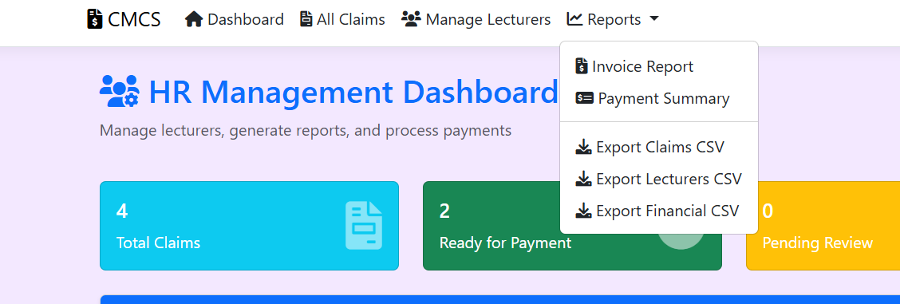
HR Management (4) Reports Dropdown The reports menu shows different types of reports you can generate from the system. There's an invoice report option for creating invoices, a payment summary for monthly payment overviews, export claims CSV to download all claims data, export lecturers CSV for lecturer information, and export financial CSV for financial summary data. This makes it easy to get the information you need in the format you want.

Slide 9
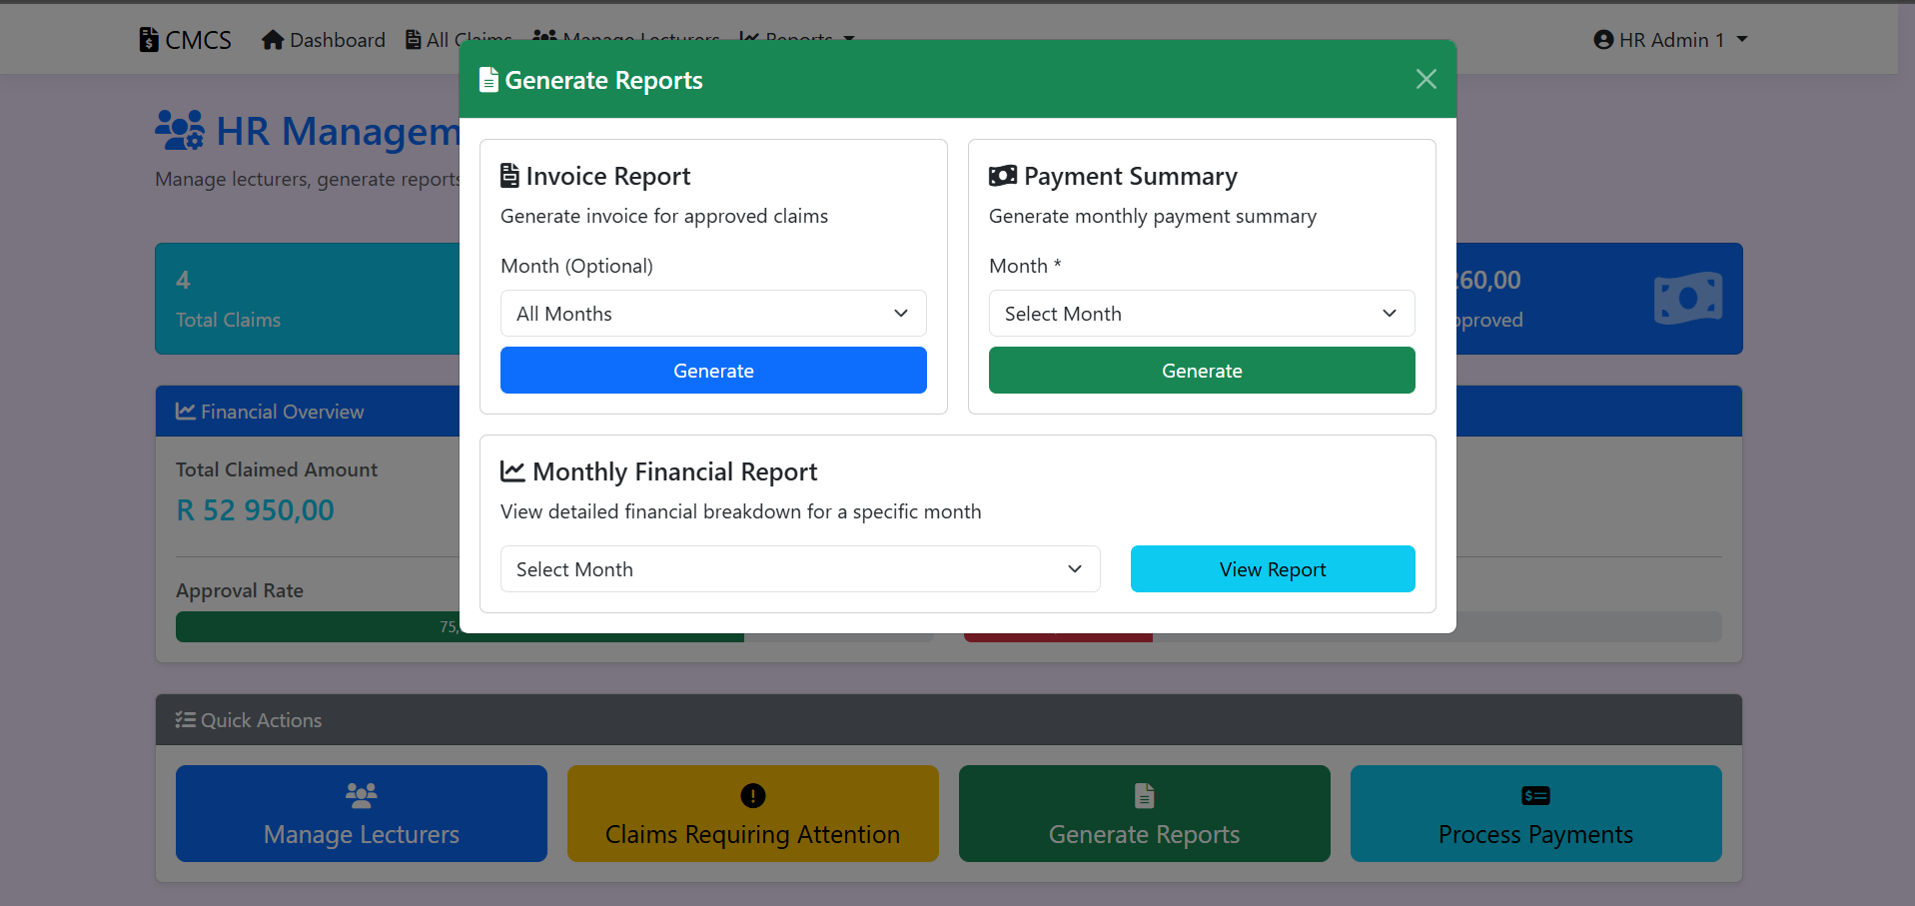
HR Management (5) Generate Reports Modal This popup window lets you create specific reports. The invoice report section lets you generate invoices for approved claims, and you can choose to filter by a specific month or select all months. The payment summary option creates a monthly payment summary, and you must select which month you want. There's also a monthly financial report option where you select a month to view a detailed financial breakdown. Each report type has its own generate button to create the report you need.

Slide 10
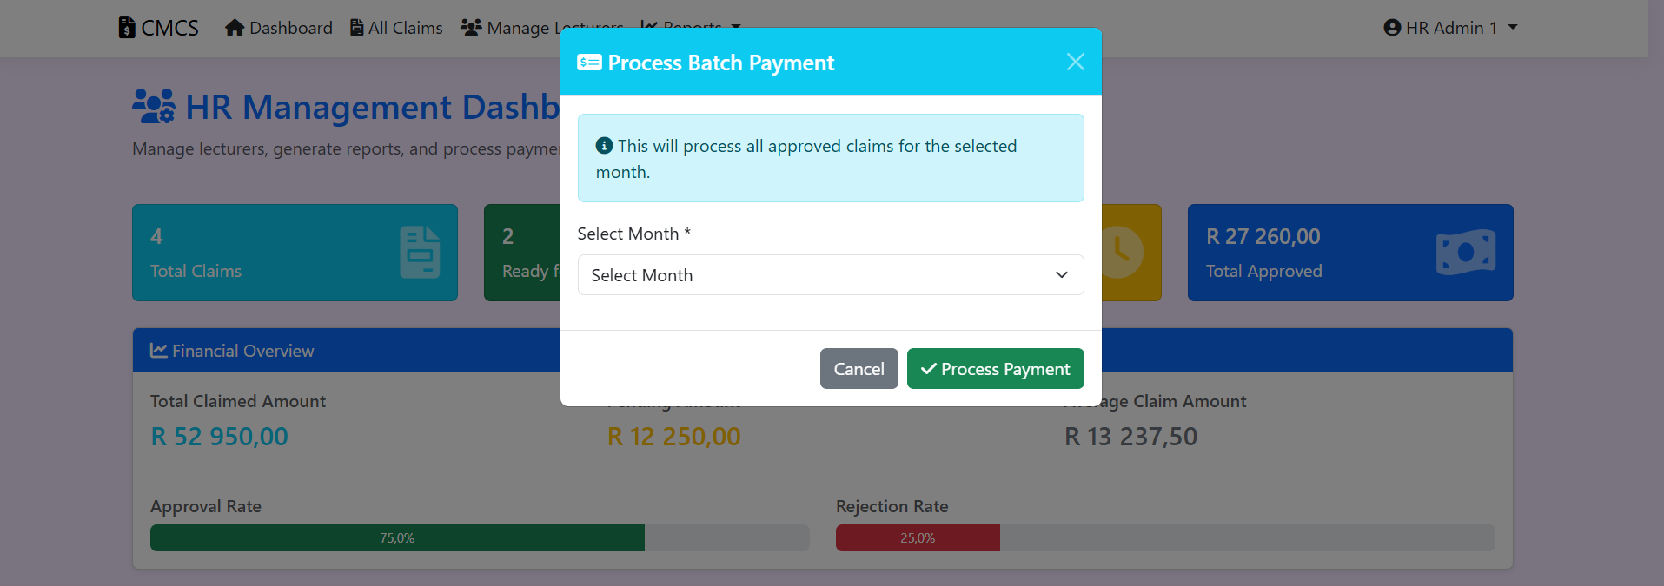
HR Management (6) Process Batch Payment This feature allows you to process payments for multiple approved claims at once. When you click on it, a dialog box appears explaining that it will process all approved claims for the selected month. You just need to choose which month's payments you want to process from the dropdown menu, then click the process payment button. This makes it much faster than processing each claim individually.

Slide 11
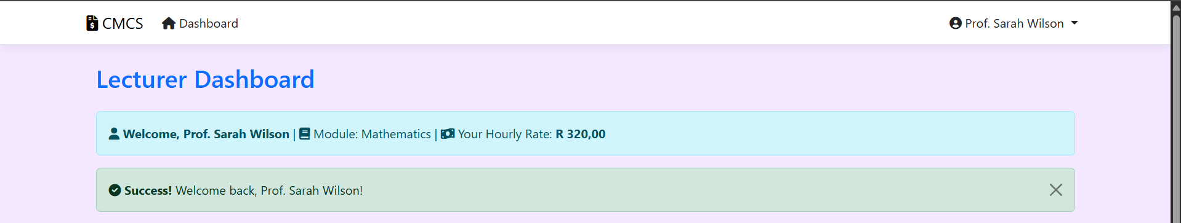
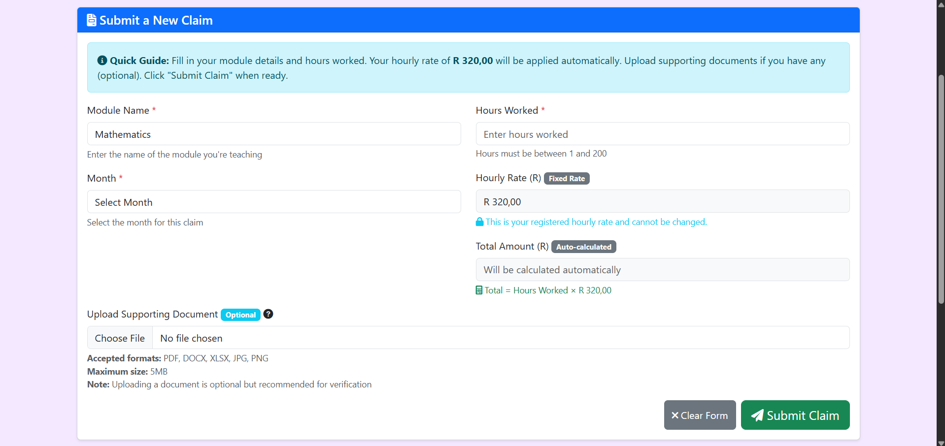
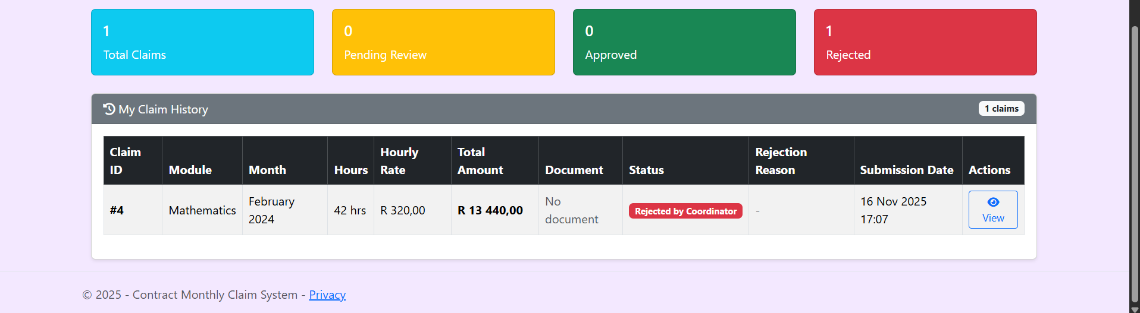
LECTURER (1) Dashboard This is what lecturers see when they log in. At the top, there's a welcome message showing their module and hourly rate. The main section is a form to submit new claims where they enter the module name, select the month, enter hours worked, and can optionally upload supporting documents. The hourly rate is automatically filled in based on their profile. Below the form are colored boxes showing their total claims, pending reviews, approved claims, and rejected claims. At the bottom is their claim history table showing all their previous submissions with details like claim ID, module, month, hours, rate, amount, status, and submission date.

Slide 12
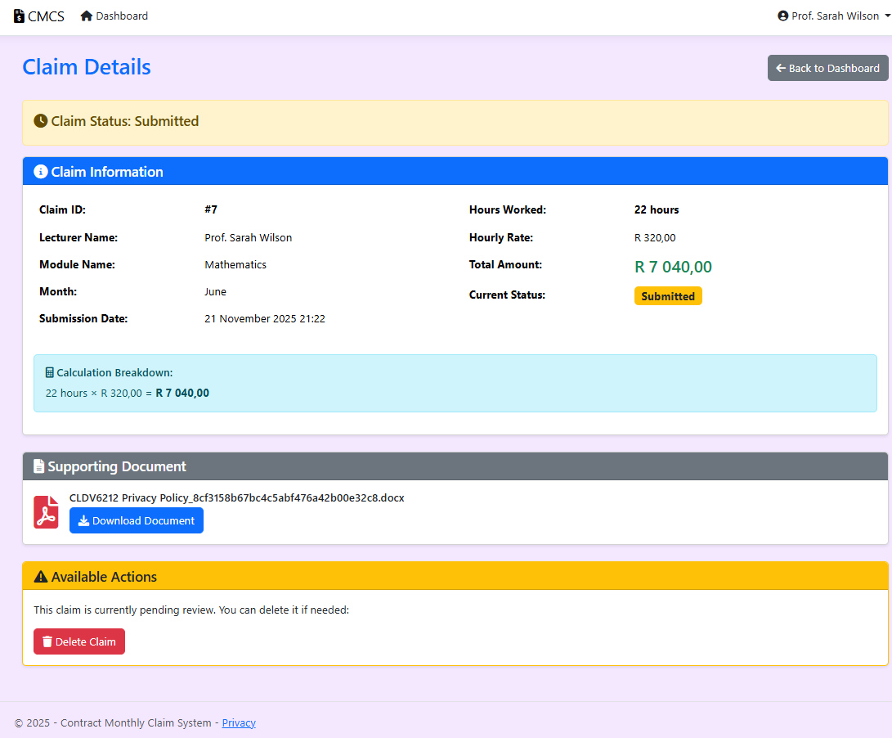
LECTURER (2) Claim Details Page This page shows all the information about a specific claim that was submitted. At the top, there's a status banner showing the current claim status, which in this case is "submitted". The claim information section displays important details like the claim ID number, lecturer name, module name, month the work was done, and when it was submitted. On the right side, you can see the hours worked, hourly rate, and the total amount calculated. There's also a calculation breakdown box that shows how the total amount was worked out by multiplying the hours by the rate. Below that is the supporting document section where you can see any files that were uploaded with the claim, and there's a download button to view them. At the bottom, there's an available actions section that tells you what you can do with the claim - in this case, since it's still pending review, you have the option to delete it if you made a mistake and need to resubmit.

Slide 13
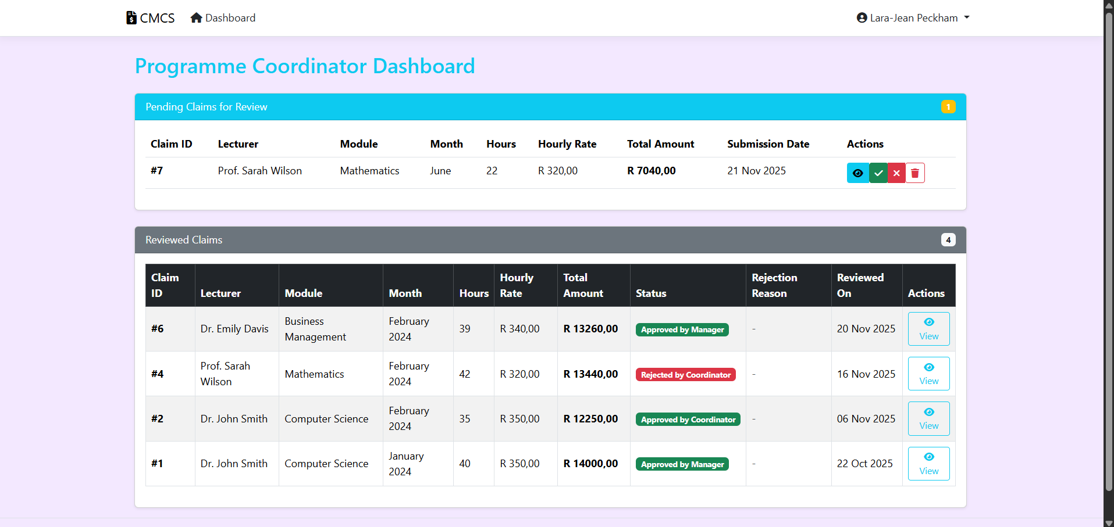
PROGRAMME COORDINATOR (1) Dashboard The coordinator dashboard shows claims that need review. The top section displays pending claims waiting for the coordinator's decision, showing the claim ID, lecturer, module, month, hours, hourly rate, total amount, and submission date. There are action buttons to view details, approve, reject, or delete claims. The bottom section shows reviewed claims with their current status - either approved by the coordinator or manager, or rejected. Each reviewed claim shows when it was reviewed and has a view button to see more details. This helps coordinators keep track of what they still need to review and what they've already processed.

Slide 14
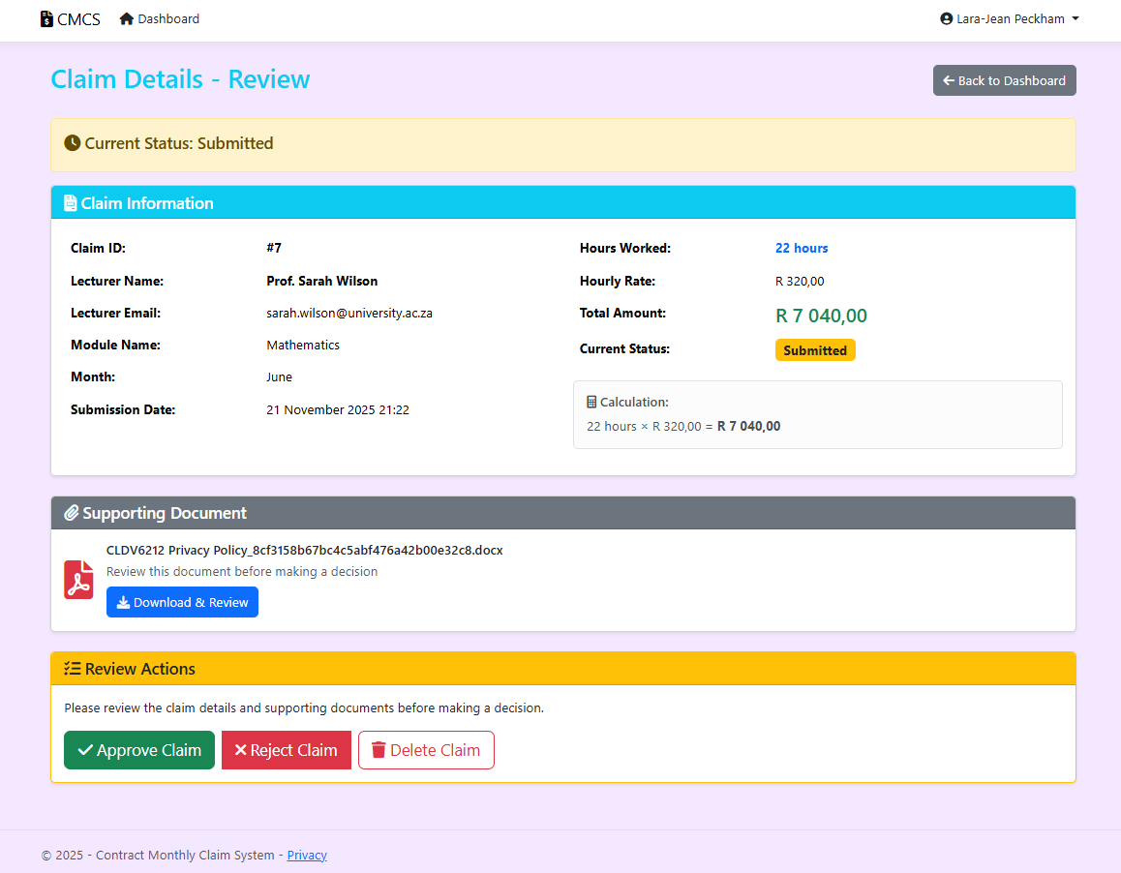
PROGRAMME COORDINATOR UI (2) Review Details Of A Claim This screen shows the page that the programme coordinator uses when they want to check a specific claim. The page displays all the important information about the claim, such as the lecturer’s details, the module name, hours worked, and the amount they are claiming. It also shows the status of the claim so the coordinator knows whether it is still pending or already processed. The layout is organised into sections, which makes it easier to read through the information and make a decision. This is the page the coordinator uses to either approve the claim or return it for correction.

Slide 15
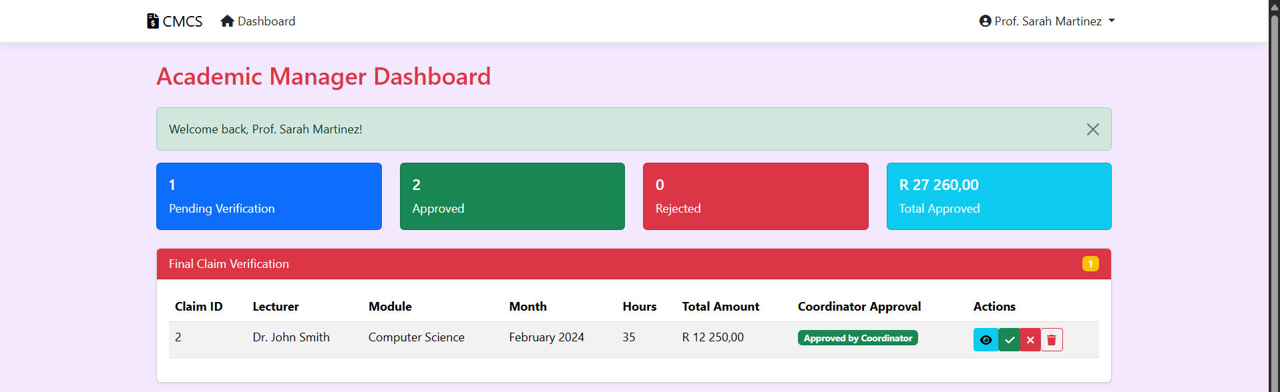
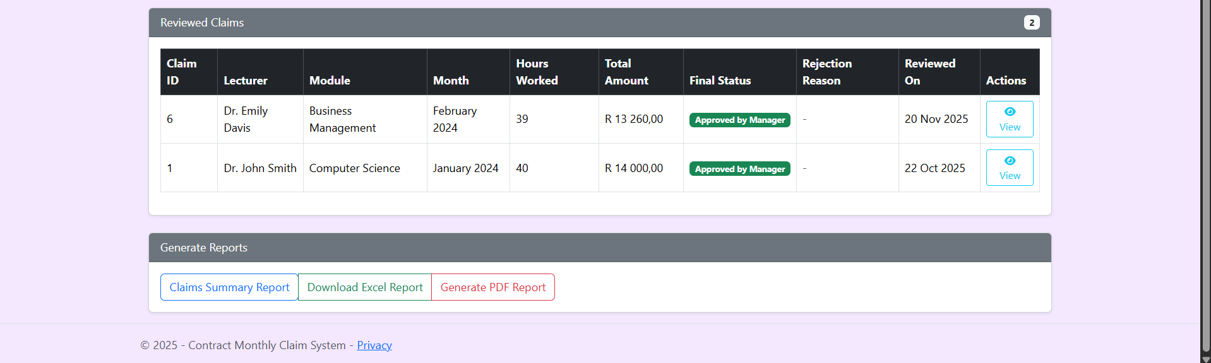
ACADEMIC MANAGER UI (1) dashboard This is the main dashboard that the academic manager sees after signing into the system. It summarises all the claims in the system using different categories, such as pending claims, approved claims, or rejected claims. The dashboard helps the manager quickly understand how many claims still need attention and which ones are ready for final verification. It also provides quick navigation to different parts of the system. The purpose of this dashboard is to keep the manager organised and help them see the overall progress of claims.

Slide 16
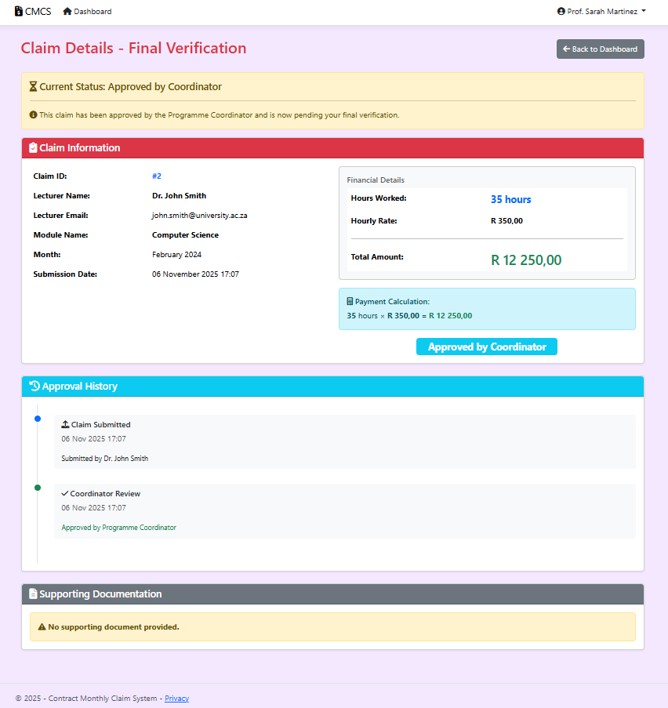
ACADEMIC MANAGER UI (2) Review Details Of A Claim This slide shows the page the academic manager uses when reviewing a claim before final approval. The page displays the lecturer’s information, financial details, hours worked, and the total amount of the claim. It also shows the claim’s history, including whether it was approved or rejected by the programme coordinator. The manager uses this screen to double-check the accuracy of the information before approving the claim for payment. There are also options to approve or reject the claim, and if the manager rejects it, they must provide a reason that will be sent back to the lecturer.

Slide 17

THANK YOU
Sthobile Mkhabela
ST10448774
PROG6212 POE PART 3 – CMCS App

